Slide 1

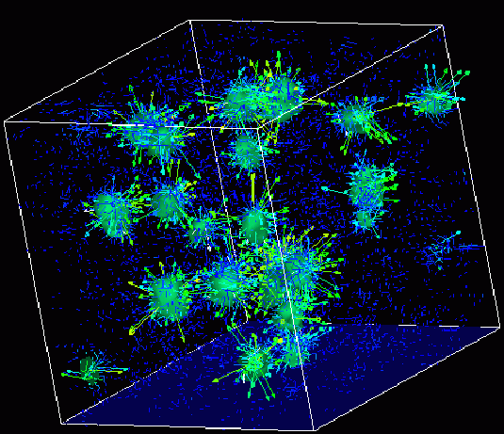
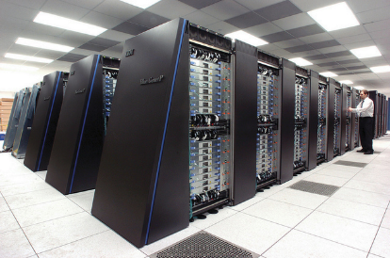
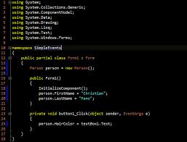
Survey of
Scientific Computing
(SciComp 301)
Dave Biersach
Brookhaven National Laboratory
dbiersach@bnl.gov
Session 22
Search Algorithms, Adjacency Matrix

Slide 2
Session Goals
Create a 2D maze on graph paper
Understand how to encode the cell walls in base 2
Learn how bitwise operators can decode a wall value
Perform file input / output using CSV and binary formats
Appreciate backtracking in depth-first search algorithm
Implement breadcrumbs using a stack data structure
Learn how to multiply two matrices
Create an adjacency matrix to improve search efficiency

Slide 3
Maze Solver
Write a program that will find a path from the entrance to the exit of a given maze
The maze should be created using a simple encoding
During the search, the program cannot receive any hints from humans – it must run autonomously
The maze is 10x10 cells, and must have at least one open path from entrance to exit cell
The complete maze perimeter must not have any holes – all outside edges must be walls

Slide 4
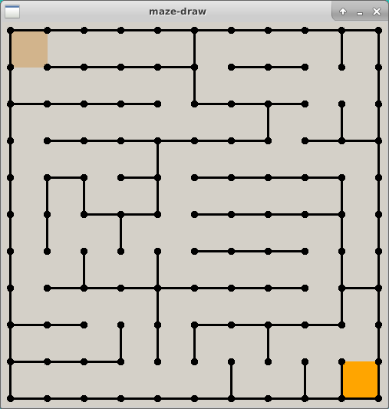
Entrance
This is a just a sample.
You will design and encode your own maze!
Exit

Slide 5
About Matrices
Matrices are named first by row, then by column
A (3 x 2) matrix has 3 rows and 2 columns
In Cartesian coordinates
The abscissa X is listed first, followed by the ordinate Y: (X, Y)
Abscissa++ moves the world point right
Ordinate++ moves the world point up
In Matrix coordinates {an array in C++}
The row is listed first, followed by the column: [Row] [Col]
Row++ moves the cell down (inverted like screen coordinates!)
Col-- moves the cell to the previous element in the current Row

Slide 6
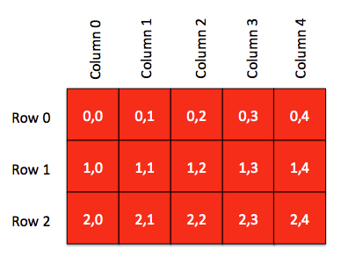
About Matrices
C++ arrays are 0-based

Slide 7
0
1
2
3
4
5
6
7
8
9
0
10 Rows
10 Cols
Y = Rows
X = Cols
Positive Y is down!
Entrance = [0][0]
Exit
= [9][9]
1
2
3
4
5
6
7
8
9

Slide 8
How do we encode a maze?
Encode each wall position as an increasing power of 2
Consider how to describe each individual square (cell) within the maze
How can we indicate for each individual cell if a wall exists to the North, East, South, or West direction?
North = 1
West = 8
East = 2
South = 4

Slide 9
How do we encode a maze?
If a wall exists in a given direction, add the value of that direction to the total cell value
North = 1
9
West = 8
East = 2
South = 4

Slide 10
How do we encode a maze?
Using a power of 2 for each wall value produces an unambiguous encoding of all wall permutations
0 ≤ cell value ≤ 15
No walls = zero (0)
15 = a totally “walled-in” cell that is unreachable (Hint: don’t make a cell = 15)
North = 1
7
West = 8
East = 2
South = 4

Slide 11
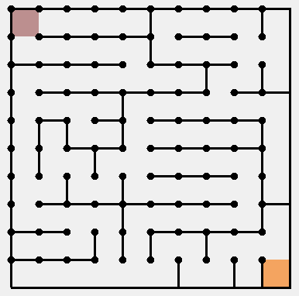
0
1
2
3
4
5
6
7
8
9
0
1
2
3
4
5
6
7
8
9

Slide 12
0
1
2
3
4
5
6
7
8
9
0
9
5
5
5
7
9
5
5
3
11
1
12
5
5
5
3
12
5
5
0
2
2
9
5
5
5
4
5
7
9
6
14
3
8
5
1
7
9
5
5
4
5
3
4
10
11
12
7
8
5
5
5
7
10
5
10
8
3
9
0
5
5
5
3
10
6
8
6
12
6
12
5
5
5
2
14
7
12
5
1
3
9
5
5
5
6
11
8
13
5
6
10
10
9
3
9
1
2
9
13
5
5
4
4
6
12
6
14
14

Slide 13
Drawing the 2D Maze
Given a maze initialized with Base 2 wall encodings, how can we draw it?
We could use a long series of if() statements to test all 16 possible values for a cell, and draw the required walls
However, this would be inefficient in code size and run time
We can take advantage of bitwise AND to figure out what walls to draw for a given cell

Slide 14
Bitwise Operators
Logical operators use double ampersand or pipe characters
Boolean X and Y conditions: if (X && Y)
Boolean X or Y conditions: if (X || Y)
Bitwise operators use single ampersand or pipe character
Bitwise X and Y values: X & Y
Bitwise X or Y values: X | Y
Logical operators only return true or false
Bitwise operators return a integer value
You normally only perform bitwise operations with byte or int

Slide 15
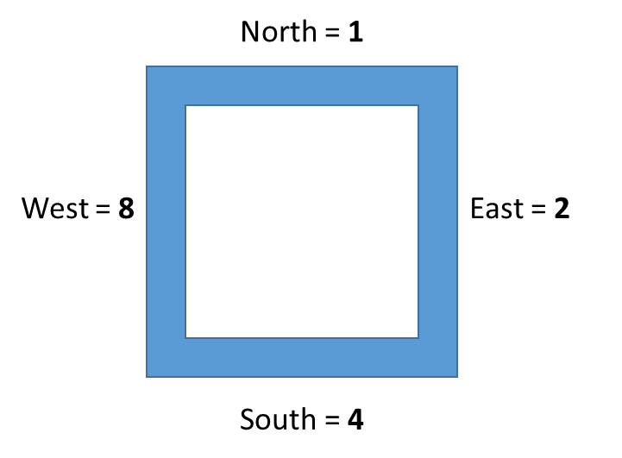
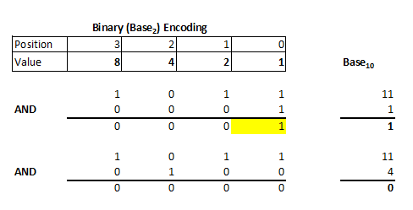
Bitwise AND
11

Slide 16
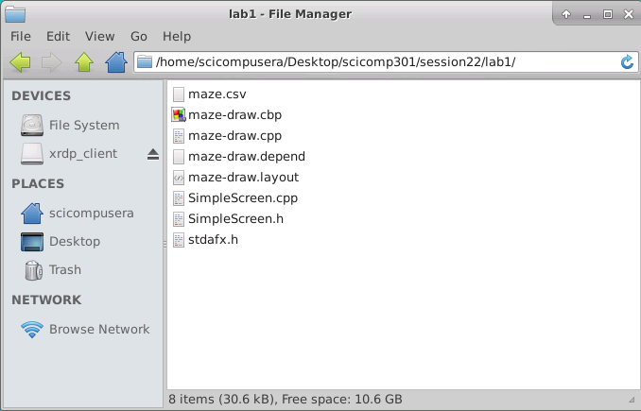
Encoding the Maze walls
Double click on the maze.csv file

Slide 17
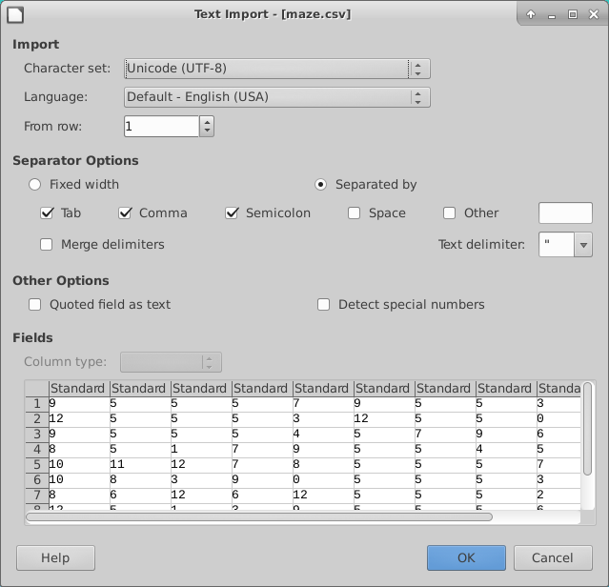
Encoding the Maze walls

Slide 18
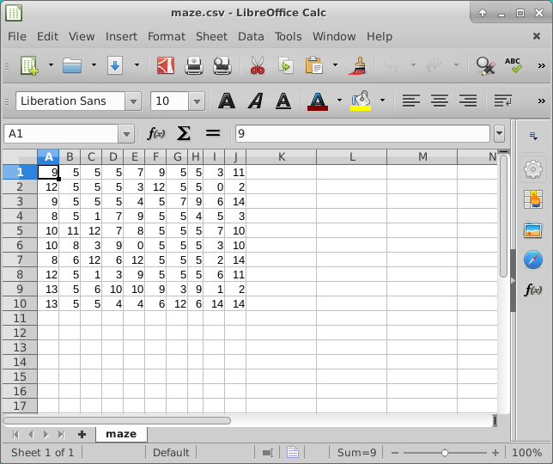
Encoding the Maze walls
Ensure you maintain a
10 x 10 matrix
as you enter your own maze cell values

Slide 19
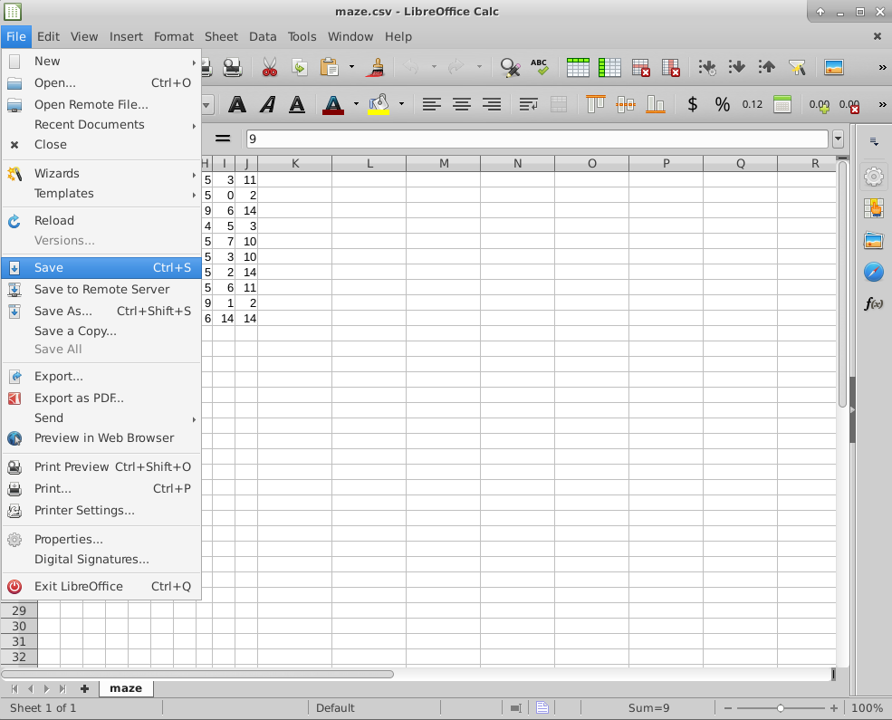
Encoding the Maze walls
Be sure to SAVE your maze file!

Slide 20
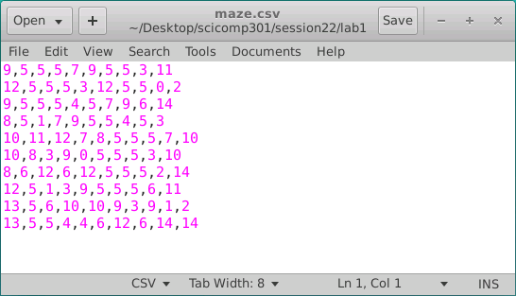
Encoding the Maze walls
CSV = Comma Separated Values
A “formatted” text file

Slide 21
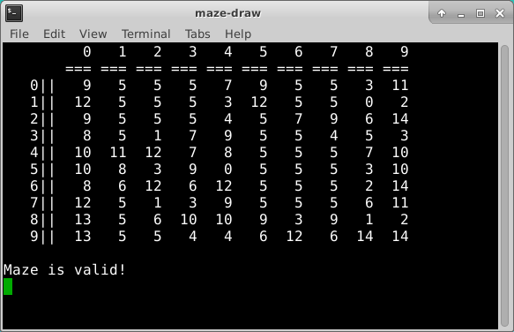
Lab 1 – Maze Draw
Now “build and run”
Lab 1 using your
maze.csv file

Slide 22
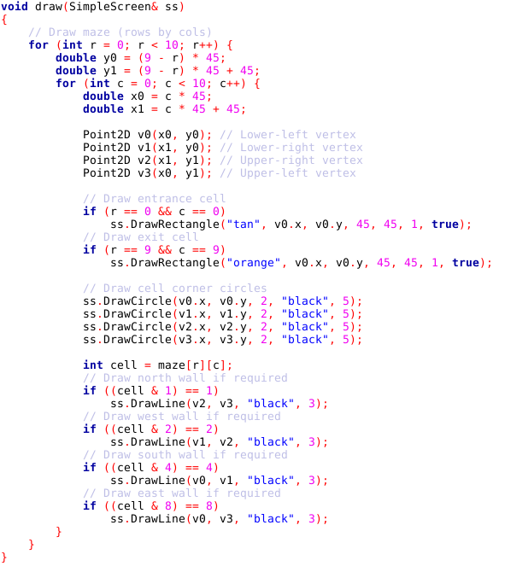
Lab 1 Maze Draw
❸
❷
⓿
❶

Slide 23
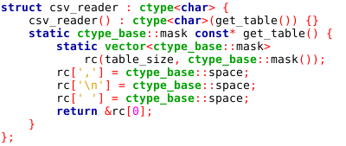
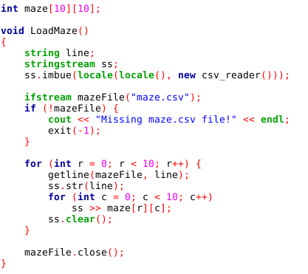
Reading CSV files

Slide 24
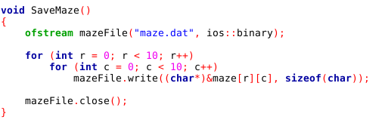
Writing data in BINARY format
maze.csv
Lab 1
maze.dat

Slide 25
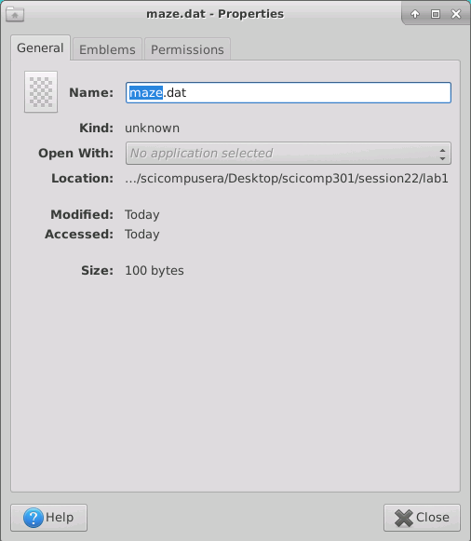
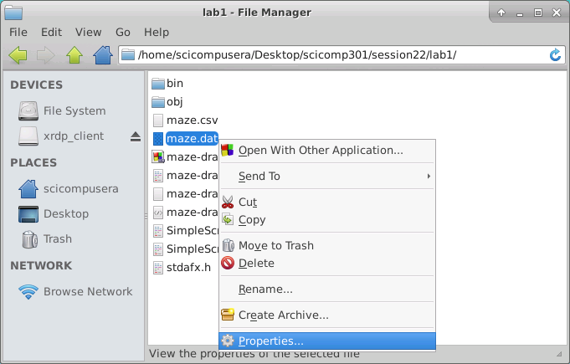
Lab 1 – Binary Output File
Right click on maze.dat and then select “Properties”
One byte for each cell in your
10 x 10 maze!

Slide 26
Lab 1 – Binary Output File
You must copy your maze.dat file to the lab2 and lab3 folders!

Slide 27
Depth-First Search
Depth-first is a sequential search algorithm
It is just you alone in the maze, you have no helpers
It is a zero prior knowledge, recursive, backtracking approach
You have breadcrumbs to mark your cell visitation history
Order of step search in each cell is North, East, South, West
We can only proceed in a direction if there is no wall in the path:
if (cell value & direction) != direction
North (1) → (Δ row = -1, Δ column = 0)
East (2) → (Δ row = 0, Δ column = 1)
South (4) → (Δ row = 1, Δ column = 0)
West (8) → (Δ row = 0, Δ column = -1)

Slide 28
Depth-First Search Algorithm
Drop a breadcrumb as you enter each cell
Take a step in the very first direction that is open, and go to step #1
If there are no more open directions in the cell, retrace your steps backwards until you reach a cell with a breadcrumb where the next open direction is one you have not taken yet
Take a step in that new direction, and go to step #1
Stop with you reach the exit square

Slide 29
Depth-First Search Breadcrumbs
A breadcrumb matrix (array) can contain a simple bool value to indicate if you have previously visited this cell
Breadcrumbs prevent going around in endless circles and never finding the exit
In this program we use an bool visitCount array, so we can color the path according to the number of times we’ve visited each cell (1=Blue, 2=Green, 3=Red, 4=Orange)
Lots of red and orange squares in the path indicates an inefficient search pattern, because you are visiting the same node too many times!

Slide 30
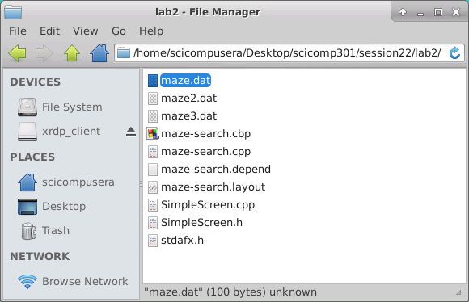
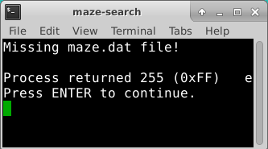
Lab 2 – Maze Search
Make sure you have copied
your maze.dat
(which was created by Lab 1)
into this Lab 2 folder

Slide 31
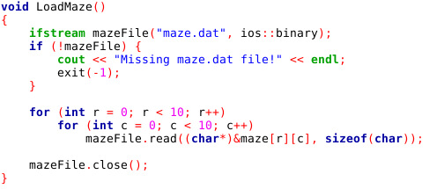
Lab 2 – Maze Search
Lab2 reads in the binary file maze.dat

Slide 32
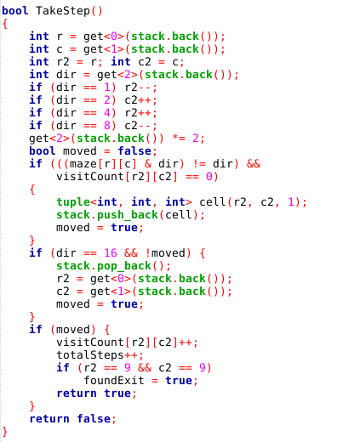
Lab 2 Maze Search
The program tries to take a step in each direction, updating the visitCount array with each step

Slide 33
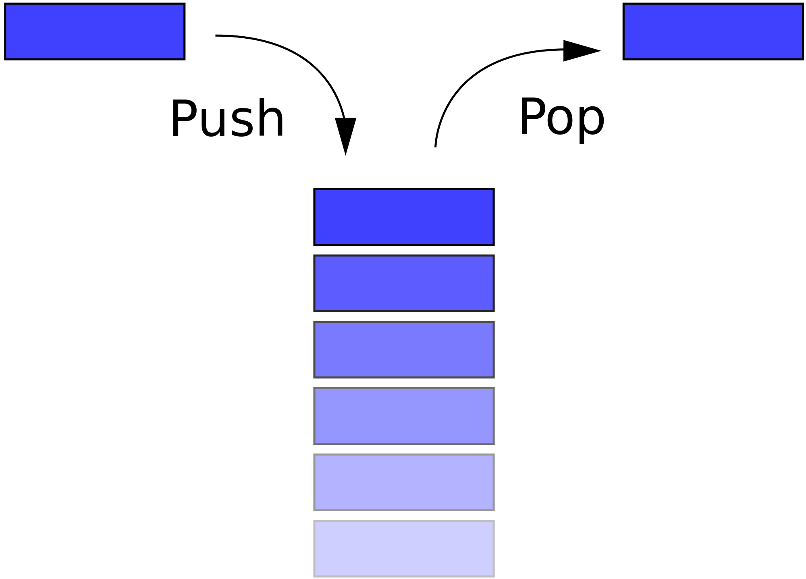
Lab 2 – Maze Draw
Entrance
We use a “stack” data structure to record the [row][col] of the navigator at each step through the maze

Slide 34
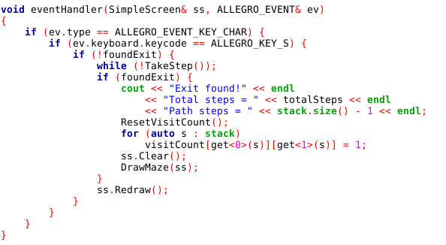
Lab 2 – Maze Search
Press S to take a single step
When the exit is found,
your path will be shown
(after removing any backup steps)

Slide 35
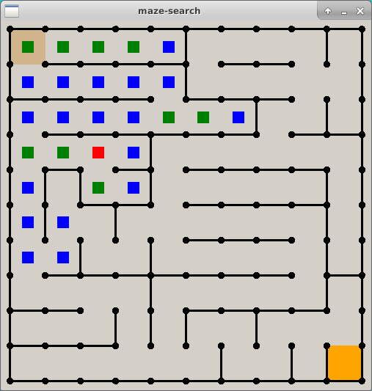
Lab 2 – Maze Search
Colors indicate the number of times a square (cell) was revisited due to backing up from dead ends or breadcrumbs
Press S to take a single step

Slide 36
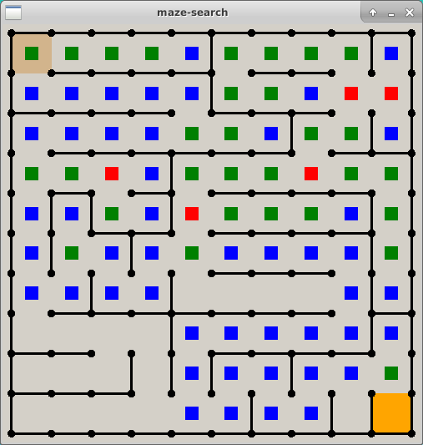
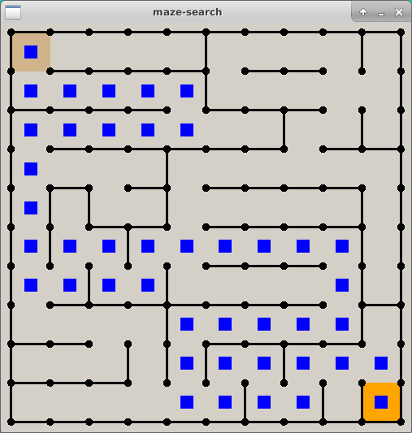
Lab 2 – Maze Search
Right before stepping into exit cell
Right after stepping into exit cell
When the exit is found, your path will be shown
(after removing any backup steps)

Slide 37
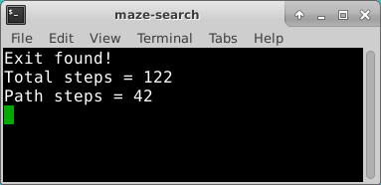
Lab 2 – Maze Search
Right after stepping into exit cell
Total steps = How many you had to take counting backup steps
Path steps = The best path you found minus any backup steps
When the exit is found, your path will be shown
(after removing any backup steps)

Slide 38
Improving Depth-First Search Efficiency
The unaided depth-first search spends considerable time exploring paths which clearly are not on the optimal route – it hits a lot of dead ends
What if we could calculate the shortest path length, and start backtracking the instant our current path length ≥ the shortest path length?
It is possible to calculate the minimum number of steps from entrance to exit (the shortest path) without searching one cell or taking one step!

Slide 39
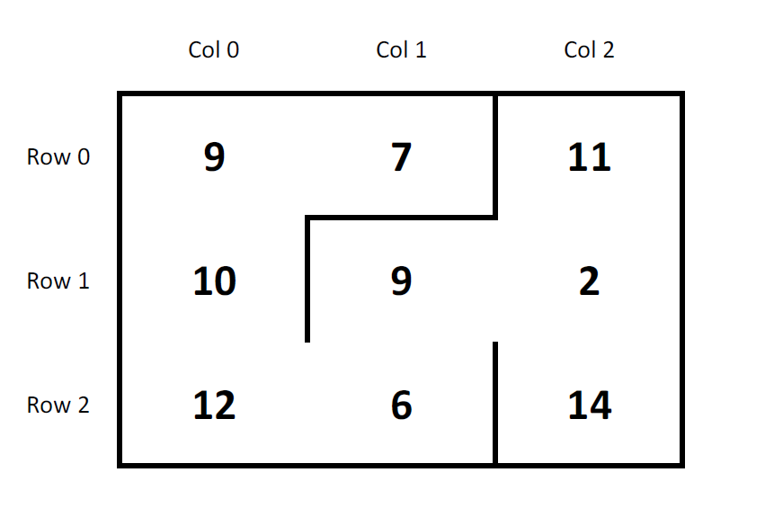
Adjacency Matrix
3 x 3 maze
9 total cells

Slide 40
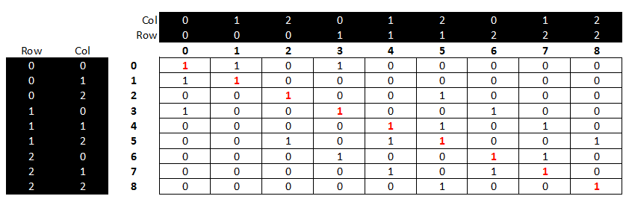
Adjacency Matrix
Every maze square (cell) is represented along both
the rows and columns of an adjacency matrix
A true (1) indicates you can reach the other cell in just one step
A false (0) means that you cannot reach the other cell in just one step

Slide 41
Adjacency Matrix
The main diagonal has all one values
because every cell can reach itself by definition
The whole matrix is symmetric about the main diagonal
because there are no “one-way” doors in the maze.
Reflexive Property: If you can get from cell A to cell B in one step,
then you can also get from cell B to cell A in one step

Slide 42
Adjacency Matrix
To find the shortest path, we keep ANDing (using the logical operator &&) the adjacency matrix against itself until a true value appears in the matrix element that represents the exit cell
The number of times we had to “multiply” (AND) the adjacency matrix by itself equals the minimal # of steps from entrance to exit
Ironically, we can know the # of steps in the shortest path, but not what the actual steps are!
But how do we multiple two matrices together?

Slide 43
Matrix Multiplication
In order to multiply 2-D matrices together the number of columns in matrix A must equal the number of rows in matrix B (Cols A = Rows B)
The resulting matrix will have as many rows as there were rows in matrix A, and as many columns as there were in matrix B (Rows A x Cols B)

Slide 44
Matrix Multiplication
Example
Matrix A has dimension (3 x 2) = 3 rows, 2 columns
Matrix B has dimension (2 x 3) = 2 rows, 3 columns
These values must match!
(3 x 2) • (2 x 3)
These two values will be the dimension of the matrix product!

Slide 45
Matrix Multiplication
Matrix multiplication is not commutative!
If we multiple B x A we will get a different matrix than if we multiple A x B
Very strange – catches even great physicists by surprise!
(3 x 2) • (2 x 3) = result is a (3 x 3) matrix
(2 x 3) • (3 x 2) = result is a (2 x 2) matrix
Welcome to the world of non-commutative algebra!
This asymmetry is the foundation of the matrix formulation of quantum mechanics

Slide 46
Matrix Multiplication
The algorithm is simple but tedious for A x B = C
Sum the product of every element in each row of matrix A multiplied by the corresponding element in each column of matrix B
That sum becomes one element in new matrix C
Continue this process for all rows in matrix A
Every row in A gets multiplied by every column in B
Output matrix has dimensions (Rows A x Cols B)

Slide 47
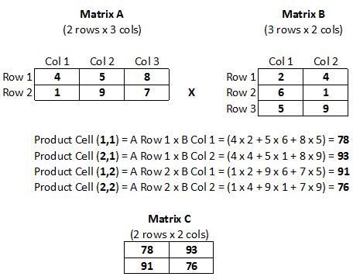
Matrix Multiplication

Slide 48
Matrix Multiplication

Slide 49
Matrix Multiplication

Slide 50
Matrix Multiplication

Slide 51
Matrix Multiplication

Slide 52
Adjacency Matrix
If it is true you can get from A to B, and it is true you can get from B to C, then it must be true that you can get from A to C (transitive property)
When “multiplying” bool adjacency matrices, if the AND of all the elements in (Row A x Col B) is == true then the cell is set to true
We keep multiplying the adjacency matrix until a true appears in the cell that represents the exit square.
The total # of matrix multiplications required = the shortest path length from entrance to exit

Slide 53
Adjacency Matrix
We can calculate the adjacency matrix before starting a depth-first search. We can then use this shortest path length to limit the current search path to improve the efficiency of the search
Once the current stack.size() has more levels than the shortest path length calculated from the adjacency matrix, start back tracking!
There is no reason to continue on a path which has a step count greater than the known shortest path – it’s best to backup and try a new direction

Slide 54
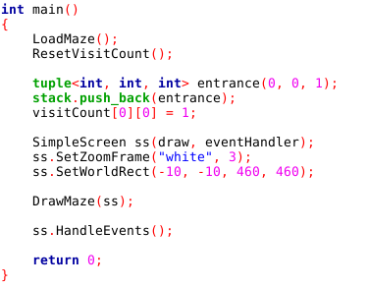
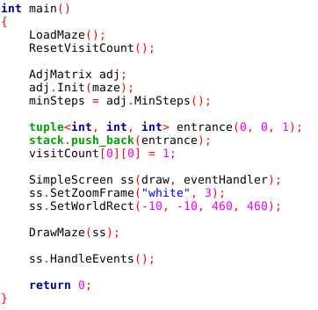
Lab 3 – Maze Search
Lab 2 – Maze Search w/o Adj Matrix
Lab 3 – Maze Search w Adj Matrix
The variable minSteps holds the # of steps in the shortest path from entrance to exit

Slide 55
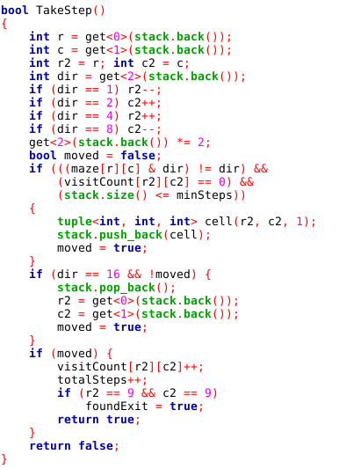
Lab 3 – Maze Search
Lab 2 – Maze Search w/o Adj Matrix
Lab 3 – Maze Search w Adj Matrix

Slide 56
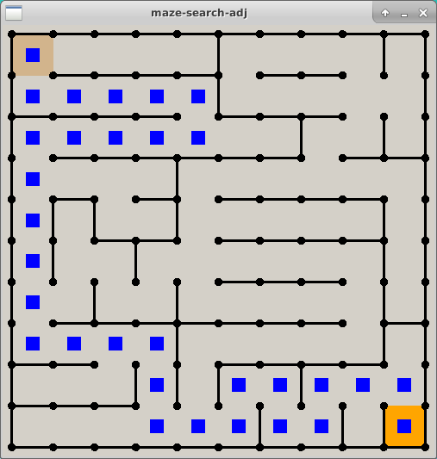
Lab 3 – Maze Search
Lab 2 – Maze Search w/o Adj Matrix
Lab 3 – Maze Search with Adj Matrix
On average using an adjacency matrix reduces the steps in a depth-first search by 40% !
Path Steps = 42
Path Steps = 30

Slide 57
Now you know…
How to encode 2D maze walls in base 2
In C++ an [Y][X] matrix means there are Y rows and X columns
The bitwise AND (&) operator can decode wall values
Depth-first search is implemented with recursion or a stack
You must use a breadcrumbs array to prevent infinite loops
A logical adjacency matrix can be used to calculate the length of the shortest path from entrance to exit
However, the adjacency matrix will not identify the actual steps along that shortest path
Leveraging the adjacency matrix during a depth-first search will yield on average a ~40% improvement in the efficiency of the search

